Slide 1
Fall 2022 KAIST Graduate School of Science & Technology Policy STP510A: National Innovation System
Tuesdays 4~6:30PM
So Young Kim
(soyoungkim.syk@gmail.com)

Slide 2
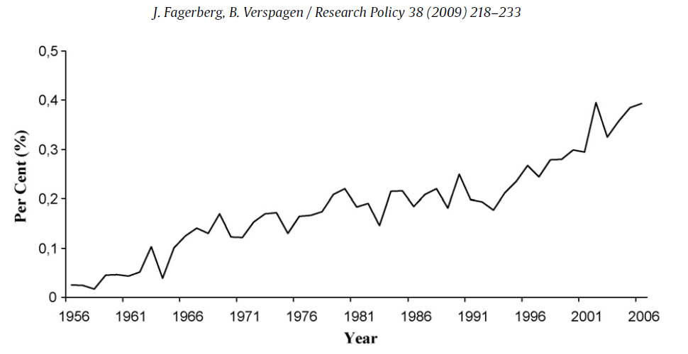
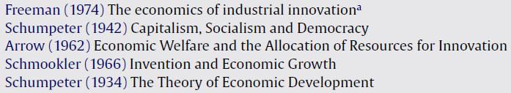
Innovation Research on the Rise
Social science articles (SSCI) with ‘innovation’ in the title
Classics before 1975

Slide 3
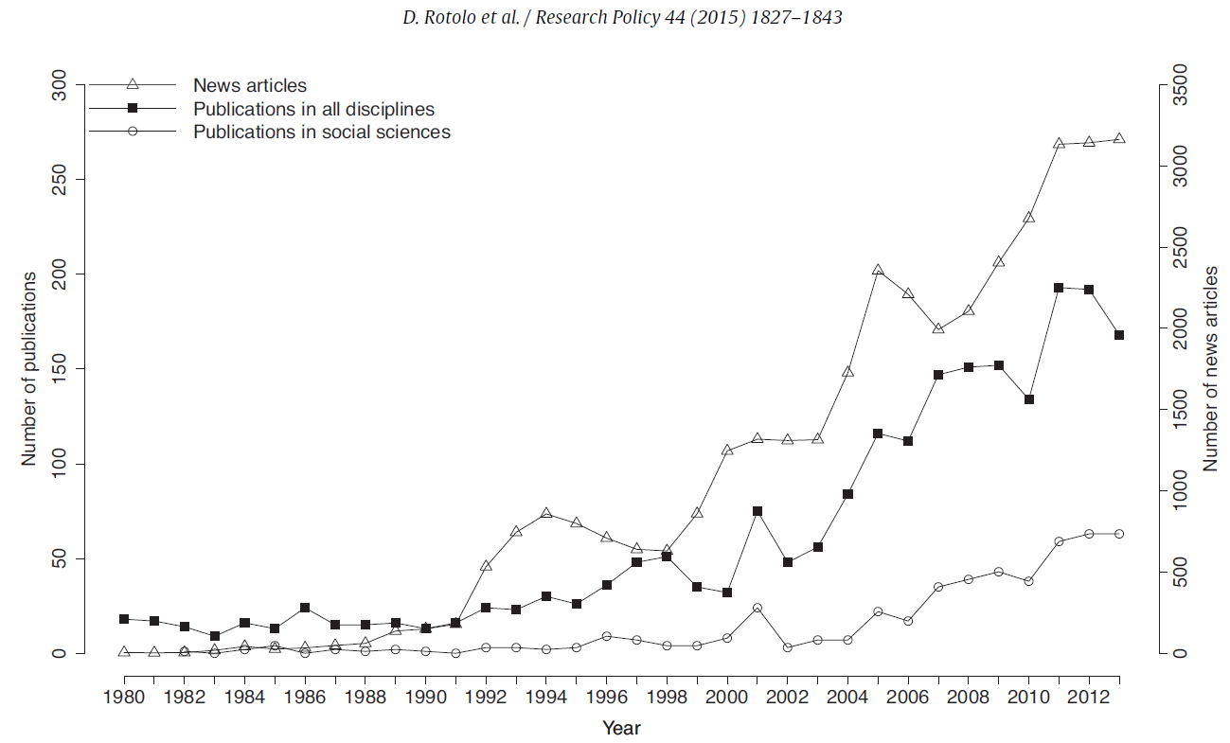
Innovation Research on the Rise
Publications retrieved from SCOPUS & news articles from FACTIVA

Slide 4
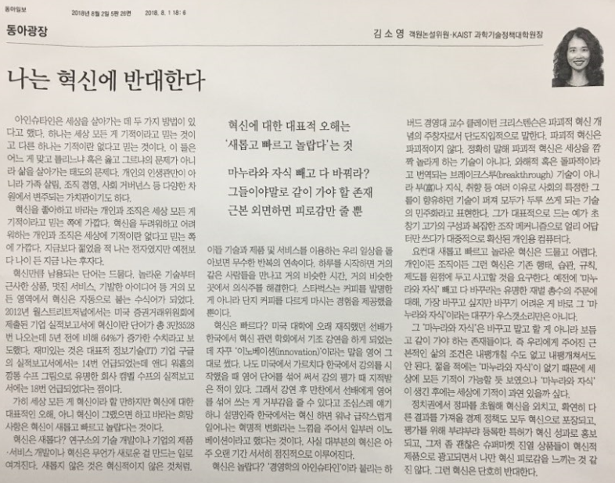
Why?
There are only two ways to live your life. One is as though nothing is a miracle. The other is as though everything is a miracle. – Albert Einstein
True life is lived when tiny changes occur. – Leo Tolstoy

Slide 5

Obsession (almost Fetishism) with the New
Undue emphasis is placed on initial invention when technology is discussed as a historical subject.
Some new technologies make a difference, but most do not.
The old survives alongside with the new and sometimes outlasts it.

Slide 6
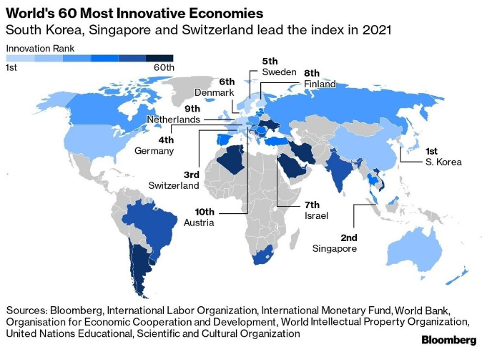
Really?

Slide 7
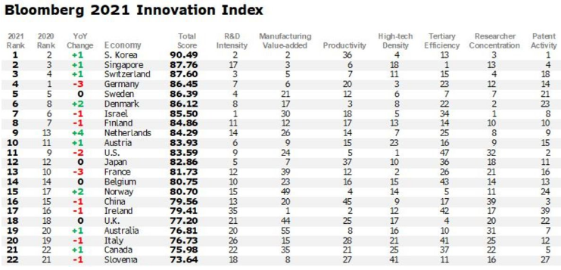
Hmm…
# of domestically domiciled technologically-oriented public companies (e.g., those in aerospace and defense, hardware, software, semiconductors, internet software/services, renewable energy industries) as % of domestic publicly listed companies and as % of world’s total public high-tech companies

Slide 8
Fundamental Insight Underlying NIS
S&T-driven growth requires more than just S&T development itself → needing to develop a whole eco-system of innovation actors and institutions
Economic value of knowledge
Knowledge increasing and becoming key to economic growth
Rise of systematic approaches
Complex feedback and dynamic relations of actors and institutions
Growing number of institutions
Large number of actors and organizations with expertise involved in the diffusion of knowledge

Slide 9
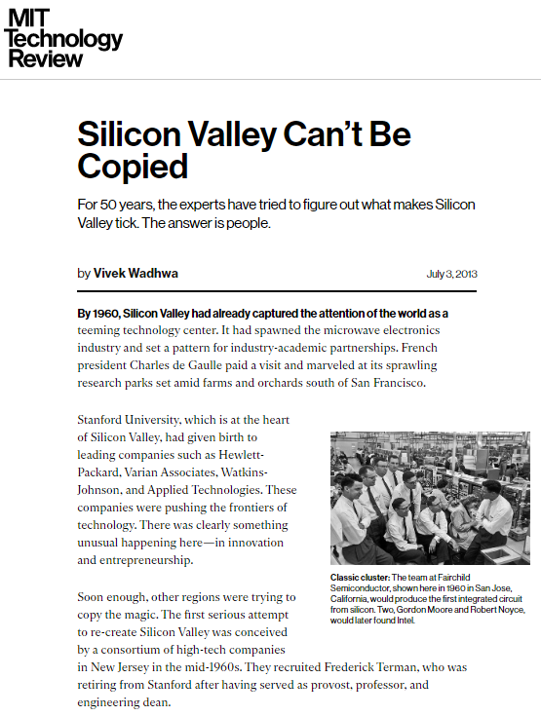
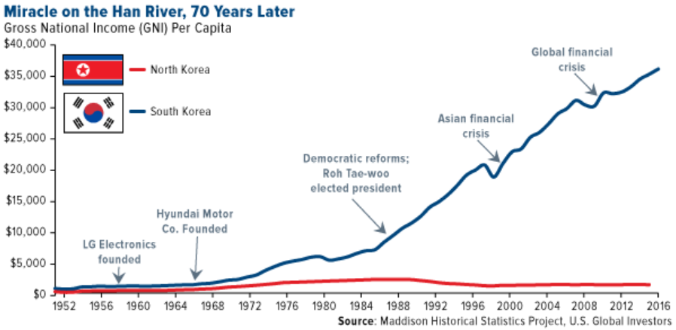
Why Silicon Valley Can’t Be Copied?
Why KAIST Can’t Be Copied?
Why the Miracle on the Han River Can’t Be Copied?

Slide 10
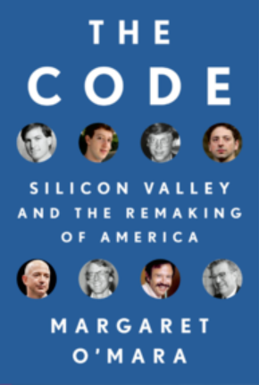
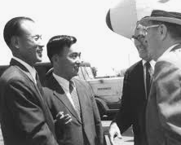
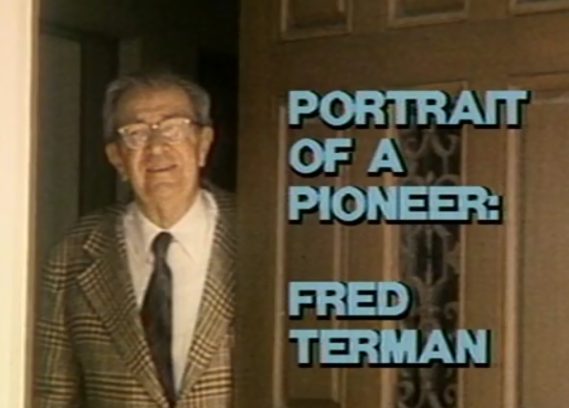
Why Silicon Valley Can’t Be Copied?
“What Porter and Terman failed to recognize is that it wasn’t academia, industry, or even the U.S. government’s funding for military research into aerospace and electronics that had created Silicon Valley: it was the people and the relationships that Terman had so carefully fostered among Stanford faculty and industry leaders.” (Wadhwa 2013)
Dr. Chung greeting Dr. Terman (1970)
Stanford University Library (1984)

